Slide 1
Using inequality notation for errors in calculations
Task A: Error intervals (addition and multiplication)
1) Work out the error interval for the perimeter of these shapes:
a)
b)
c)
c
w
b
l
a
2.5 ≤ l < 3.5
2.25 ≤ w < 2.35
4.5 ≤ a < 5.5
7.85 ≤ l < 7.95
11.5 ≤ b < 12.5
2.5 × 4 ≤ p < 3.5 × 4
2(2.25+7.85) ≤ p < 2(2.35+7.95)
12.5 ≤ c < 13.5
10 ≤ p < 14
20.2 ≤ p < 20.6
28.5 ≤ p < 31.5
2) Work out the error interval for the area of these shapes:
a)
b)
c
4.5 ≤ a < 5.5
b
11.5 ≤ b < 12.5
Lower area : 0.5 × 4.5 × 11.5
Upper area : 0.5 × 5.5 × 12.5
25.875 ≤ area < 34.375
a
4.25 ≤ l < 4.35
4.25² ≤ a < 4.35²
18.0625 ≤ a <18.9225

Slide 2


Using inequality notation for errors in calculations
3) Given the error interval of the area, can you work out the rounded lengths and the degree of accuracy?
Square with lengths
8.3 cm (1 d.p)
≤ l <
8.25 ≤ l < 8.35
68.0625 cm² ≤ area < 69.7225 cm²
Task B: Error intervals in calculations
A rope was originally 5.3 cm (1 d.p). A piece of 3.8 cm (1 d.p) was cut from the rope. What is the error interval for the remaining length?
Original length
5.25 ≤ l < 5.35
Upper limit remaining : 5.35 - 3.75 = 1.6
Lower limit remaining : 5.25 - 3.85 = 1.4
Cut length
3.75 ≤ c < 3.85
Remaining length
1.4 < remaining < 1.6

Slide 3
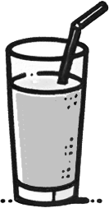
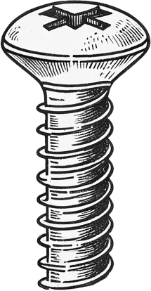

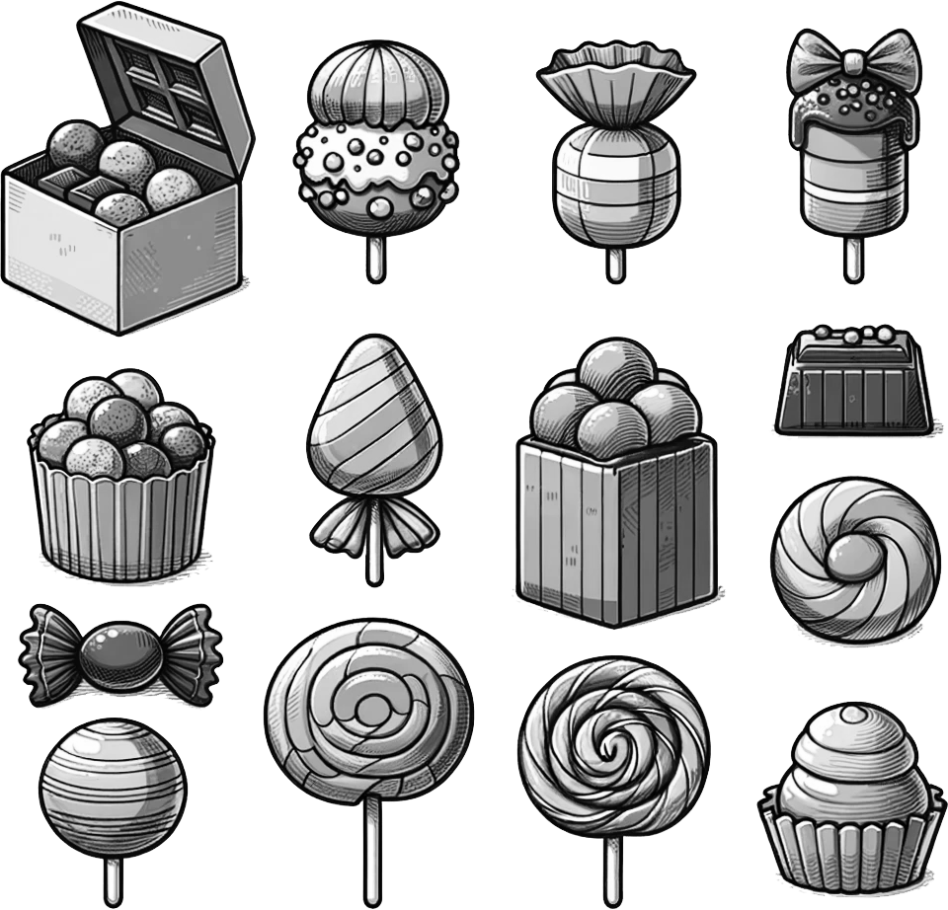
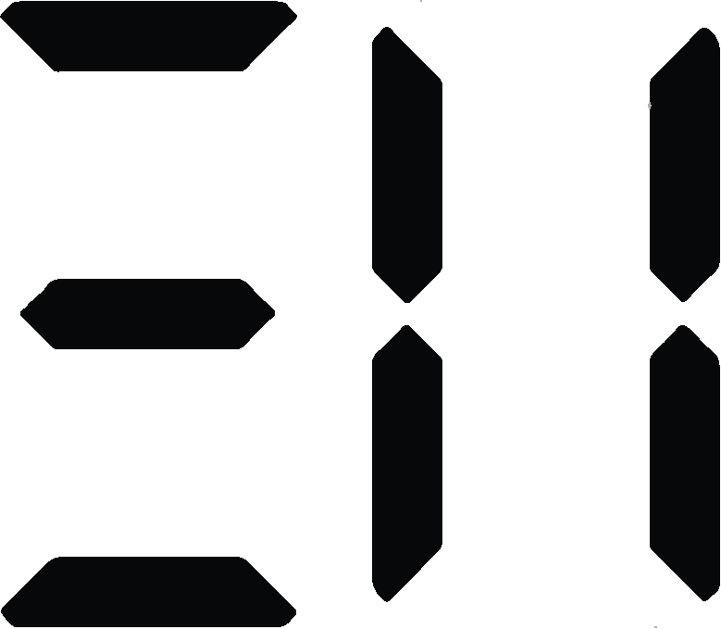
Using inequality notation for errors in calculations
2) A coffee had 330 ml (the nearest integer) and Lucas drank 32 ml (2 s.f.). What is the error interval for the remaining coffee?
Original full coffee
329.5 ≤ c < 330.5
Upper limit remaining : 330.5 - 31.5 = 299
Lower limit remaining : 329.5 - 32.5 = 297
Amount drank
31.5 ≤ d < 32.5
Remaining coffee
297 < coffee < 299
3) A screw has broken off from a wall.
Originally the screw was 4.6 mm (1 d.p).
The broken off piece measures 3.4 mm (1 d.p).
Work out the error interval length of the screw which is lodged in the wall.
Original full screw
4.55 ≤ s < 4.65
Upper limit lodged in wall : 4.65 - 3.35 = 1.3
Lower limit lodged in wall : 4.55 - 3.45 = 1.1
Broken off
3.35 ≤ b < 3.45
Lodged in wall
1.1 < l < 1.3
4) A box of sweets and a chocolate weigh 43.26 g correct to 2 d.p.
If the chocolate alone weighs 21.14 g (2 d.p), what is the error interval for the mass of the box of sweets?
Total mass
43.255 ≤ m < 43.265
Upper limit sweets : 43.265 - 21.135 = 22.13
Lower limit sweets : 43.255 - 21.145 = 22.11
Chocolate
21.135 ≤ c < 21.145
Mass of Sweets in box
22.13 < s < 22.11
Mathematics in Education and Industry
v2.3

